Slide 1

LinkedIn Administration
Sprint 5

Slide 2

Team Byte me Dirty Bits!
Project Manager : Julian
Scrum Master : Jon
Programmer 1: Vishek
Programmer 2: Gloria
Tester: Kevin

Slide 3

The Goal of our application
Business Value
Target Audience
Competition
Notes:
Talk about what the linkedin app is
Focus on the admin component
Target Audience
Faculty and staff of Georgia State who may want to contact previous alumni.
I think this application can also work for other institutions who may want to
Business Value
Save Time
Instead of spending hours doing individual searches, our application can find all those alumini or individuals within minutes and have them listed in the csv file.
Competition
Atleast in Georgia State there isn’t an application like this. So faculty and staff would benefit by using our app. Again I think what makes this app very unique is that it is tailored to Georgia State as you can see with the front end of the application. The login and registration and the CSV results file is also unique to this app.

Slide 4
Notes:
conceptual model from the backlog sprint
In terms of the final product with the admin app I think we were able to accomplish what we originally set with this conceptual model. We were also able to add polling to this which wasnt considered originally when we drew this model. Our major setback was I believe the Linkedin API issue which the backend team had. I think we didn’t really get to integrate everything together like we wanted to and get real data from linkedin. Since this is a three team project the success of the whole project relied on all three teams modules working.

Slide 5
Login/Registration
Limits the access of overall application to just GSU faculty and staff
Allows for users to save their queries for use at a later time

Slide 6
XML to CSV
Core functionality of application
Notes:
-pretty straightforward but most important, only thing that really needs to work for our application to be of any use
-allows for user to read results in a easy form and also in a form that can be utilized in potentially other ways

Slide 7
Polling
The only feature that was absent from original conceptual model
A necessity due to the unpredictable amount of time for query request completion
Notes:
-describe the basic function of polling

Slide 8
Integration with Java RMI
Allows for frontend and backend teams to use admin app remotely
RMI allows for each team to work on overall project on one computer
Notes:
-restate this in different works, elaborate maybe on why this is positive

Slide 9
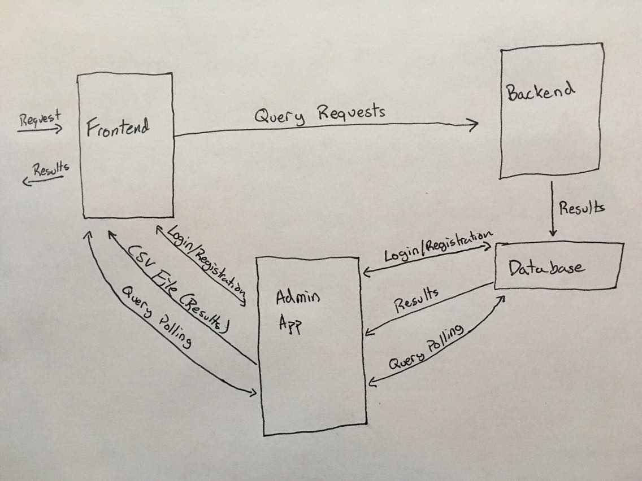
New Conceptual Model
Notes:
Incomplete stories were:
-Overall integration between all three applications
-Testing our application after this integration
-Finished our application last week
-safe to say we used all the time we were allotted for completion of this application

Slide 10


Questions?
Thank You

